Slide 1
Lecture 4 Array Basics
Abrar Hasan
Lecturer
Dept. of Software Engineering
Daffodil International University

Slide 2
1
Table of contents
2
3
<
T
0
>
Array
Operation of Array
Searching Algorithm

Slide 3
1
Array
<
T
1
>

Slide 4
Array
<
T
1
>
Array is a linear data structure which is used to store similar type of data.
Notation:
int a [n]
float array[100]
Size of array

Slide 5
Memory Allocation of Array
<
T
1
>
Suppose an array
A [6] = {10,43,3,41,15,64}
It is stored like this in Ram Memory
10
0x100
10
43
3
41
15
64
Consecutive Memory Location
43
0x104
0
1
2
3
4
5
3
0x108
How we see an array
15
0x112
64
0x114

Slide 6
Dimension of Array
<
T
1
>
One Dimensional Array
int a [n]
Multidimensional Array

Slide 7
Multidimensional Array
<
T
1
>
int a[n][n]
a[2,0]
a[2,1]
a[2,2]
Example: int a[3][3]
a[1,0]
a[1,1]
a[1,2]
10
18
21
a[0,0]
a[0,1]
a[0,2]
3
21
67
1
51
2
Indexing

Slide 8
Properties of Array
<
T
1
>
It can hold multiple values of a single type.
Elements are referenced by the array name and an index.
Each element is a value
Indexing begins at zero.

Slide 9
2
Operation of Array
<
T
1
>

Slide 10
Array Operation
<
T
2
>
Traversal
Insertion
Deletion

Slide 11
Traversal
<
T
2
>
Traversal: Accessing and processing each element in the data structure.
int a [3] = {1,2,3};
for (int i=0;i<3;i++)
{
cout<<a[i]<<endl;
}

Slide 12
Insertion
<
T
2
>
Adding a new data to an empty or filled location of an array

Slide 13
Insertion
<
T
2
>
In empty array, new values are stored in empty location
int main()
{
int a [3];
a[0] = 1
}

Slide 14
Insertion
<
T
2
>
In filled array, old values are either replaced or moved backward
int a [6] = {1,2,3,4,5};
for(int i =4;i>=0;i--)
{
a[i+1]= a[i];
}
a[0] = 6;
for(int i=0;i<6;i++)
{
cout<<a[i];
}

Slide 15
Deletion
<
T
2
>
Delete an item from specific location
The item behind that location is moved one step forward
int a [6] = {1,2,3,4,5,6};
for(int i =0;i<5;i++)
{
a[i]=a[i+1];
}
a[5] = '\0';

Slide 16
3
Searching Algorithm
<
T
3
>

Slide 17
Linear Search
<
T
3
>
The searching technique which traverses the whole array sequentially to locate the desired item is called Linear Search.
It iterate over the whole array.
Compares each element with desired data. If found it returns the location/ index.

Slide 18
Linear Search
<
T
3
>
int a [6] = {1,2,3,4,5,6};
for(int i=0;i<6;i++)
{
if(a[i]==4)
{
cout<<i<<endl;
break;
}
}

Slide 19
Complexity of Linear Search
<
T
3
>
for(int i=0;i<n;i++)
{
if(a[i]==key)
{
cout<<i<<endl;
break;
}
}
O(n)

Slide 20
Binary Search
<
T
3
>
Perquisite of Binary Search:
The array must be sorted

Slide 21
Binary Search
<
T
3
>
Steps:
1. Lets assume the array is sorted in ascending order.
2. At first we take two indexes,
left index is the first of the array
right index is the final of the array.
3. Then we find the middle index of the array
4. If the middle index and the diseased value is equal, the index is returned.
5. If Middle value is less than key value, left index = middle+1 index
6. If Middle value is greater than key value, right index = middle-1 index

Slide 22
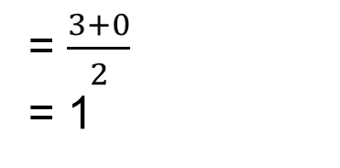
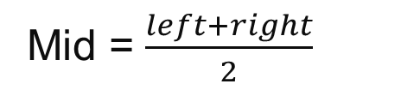
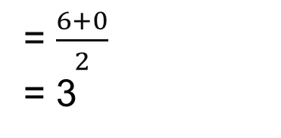

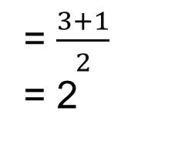
Binary Search
<
T
3
>
Target Number = 3
Mid = $\frac{left+right}{2}$
Mid = $\frac{left+right}{2}$
1
1
2
3
4
5
6
0
3
4
5
6
0
= $\frac{6+0}{2}$
= 3
= $\frac{3+0}{2}$
= 1
= $\frac{3+1}{2}$
= 2
1
2
5
6
7
1
2
3
4
5
6
7
4
4 == 3 ?
4 < 3 ?
2 == 3 ?
2 < 3 ?
4 > 3 ?
3 == 3 ?
2 > 3 ?

Slide 23
Binary Search
<
T
3
>
first = 0;
last = n - 1; //n=total length
middle = (first+last)/2;
while (first <= last) {
if (array[middle] < search)
first = middle + 1;
else if (array[middle] == search)
{
printf("%d found at location %d.\n", search, middle+1);
break;
}
else
last = middle - 1;
middle = (first + last)/2;
}
if (first > last)
printf("Not found! %d is not present in the list.\n", search);
1
2
3
4
5
6
7
8

Slide 24
Binary Search Time Complexity
<
T
3
>
0
1
2
3
4
5
6
7
O(log(n))

Slide 25
Thank You

